Slide 1


183 DB Midterm Presentation
Week 4 Team Parsley
Lin Li, Amir Omidfar, Wilson Chang, Angel Jimenez

Slide 2
Table of Contents
Mathematical Model
Simulation
System Design and Software
Motor & Mass Control

Slide 3
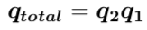
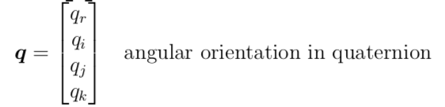
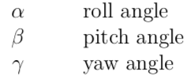
Euler Angle → Quaternion
Avoid Gimbal-lock problem
No Trigonometry function in Rotation Matrix
Useful properties
Angular Acceleration

Slide 4
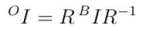
Newton’s Second Law of Rotation
Torque introduced by:
Point torque with no positional dependence
Torque introduced by force depending on distance from CoM
Moment of Inertia is a tensor and is dependent on reference frame

Slide 5
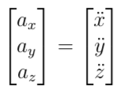
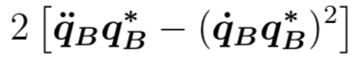
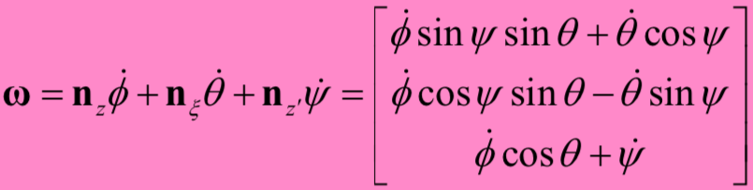
Orientation is hard
Linear Acceleration Angular Acceleration

Slide 6

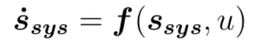
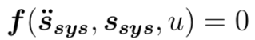
Math is hard
Instead of the form:
We are getting this form:
And lineralized it at each operating point.

Slide 7
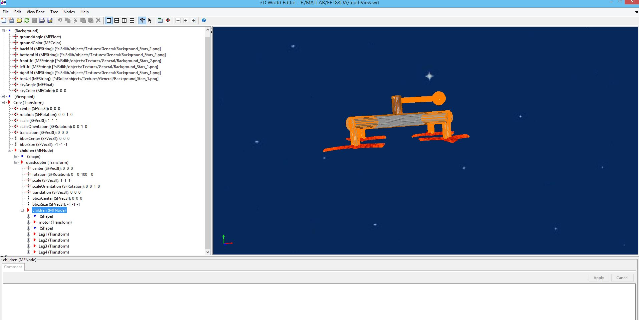
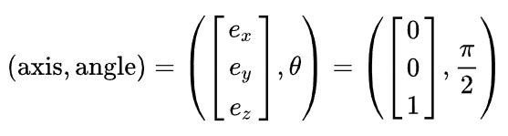
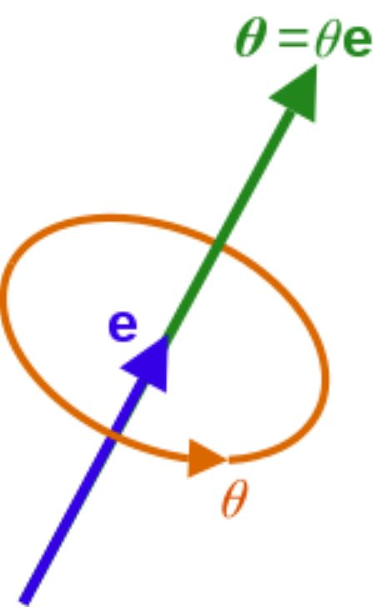
Simulation : 3D World Editor
Designer Interface
Axis-angle representation

Slide 8
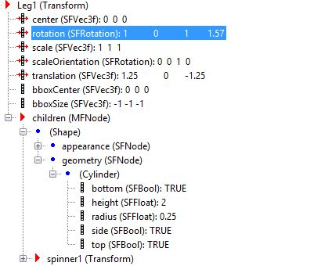
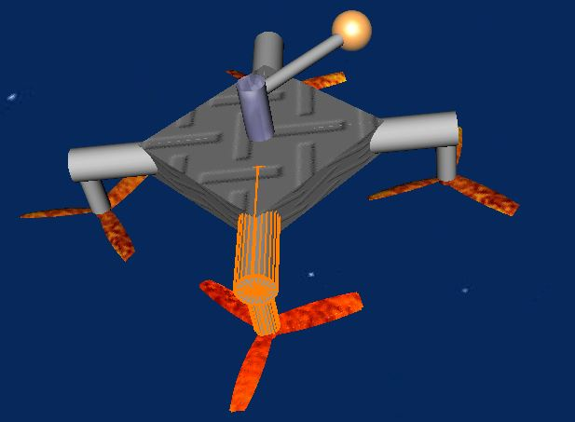
Simulation: Building 3D Geometric Structure

Slide 9
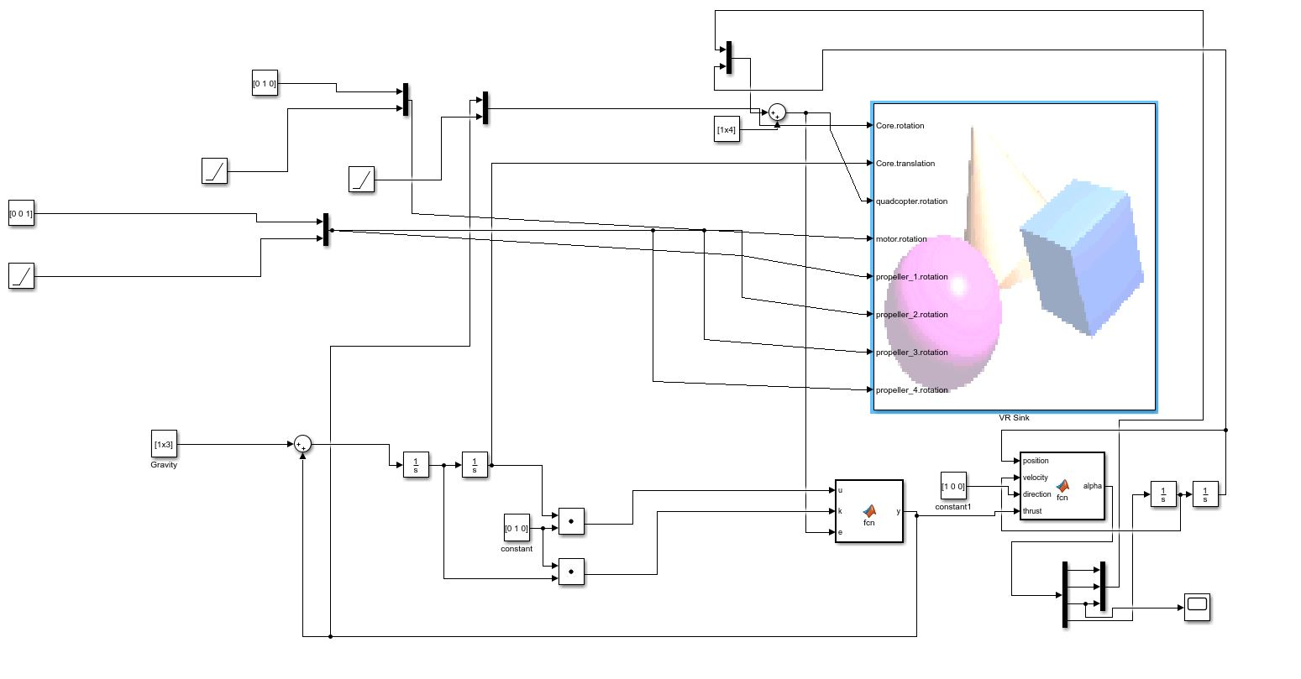
Simulation : Simulink Schematic
Simulink block diagram for the simulation test

Slide 10
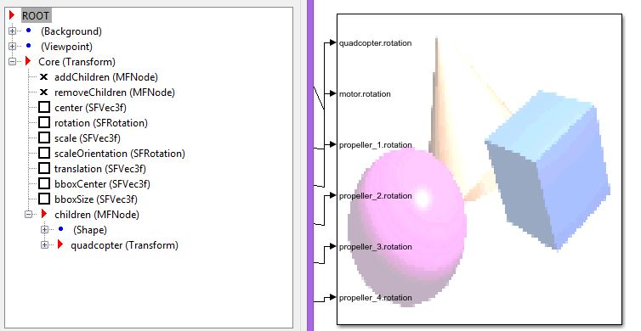
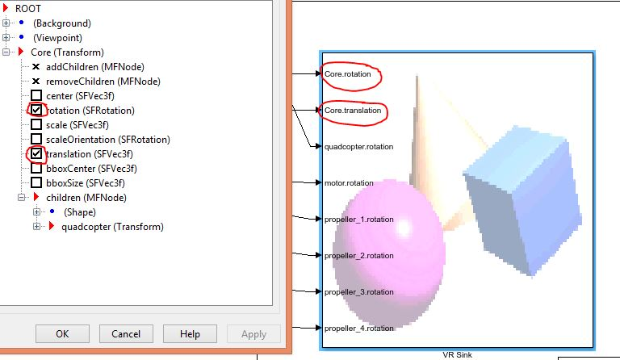
Simulation: Updating State Information
Before adding the state updating gate
After adding the state updating gate

Slide 11

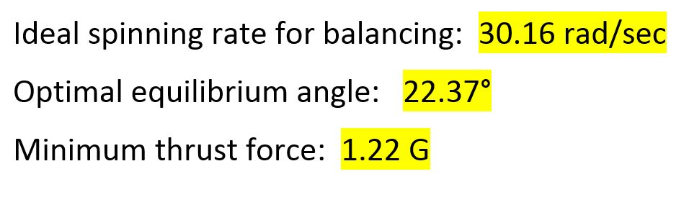
Simulation : Tests and Conclusion
The key parameters that are obtained from the simulation
Simulation Test Video: https://www.youtube.com/watch?v=o9f2x5YUPoA&t=1s

Slide 12
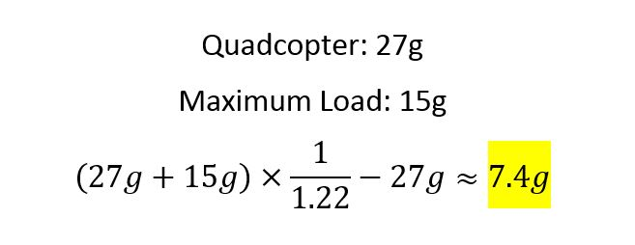

Simulation: Result Demo Video
Demo Video: https://www.youtube.com/watch?v=YP-726upKFU
The key parameters that are obtained from the simulation
Actual available load for the controller
Application
Example

Slide 13
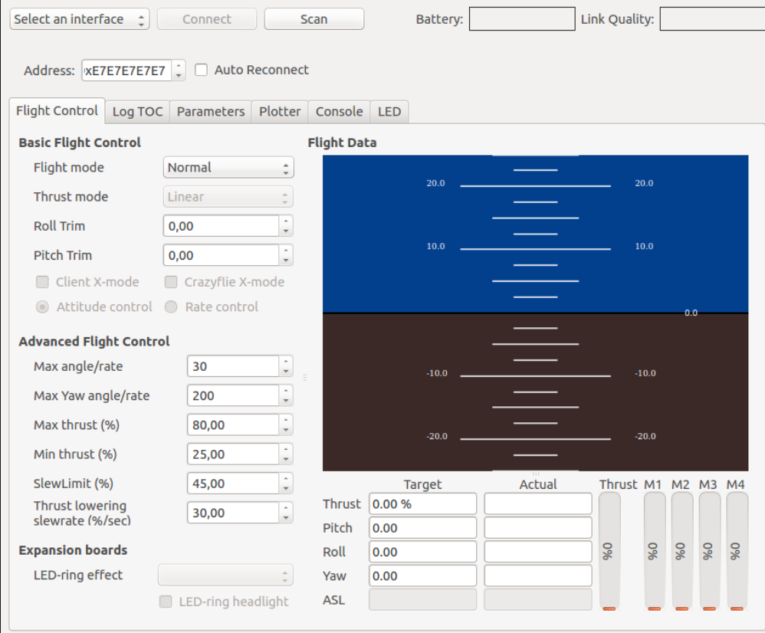
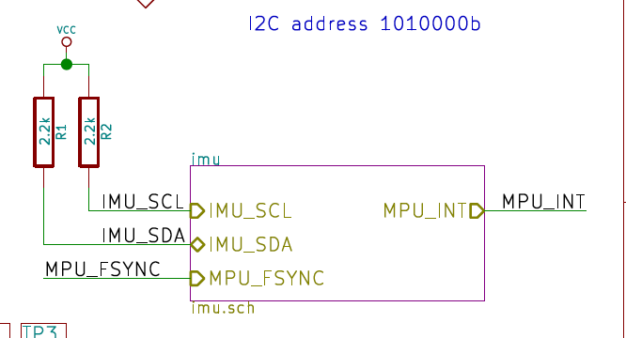
CrazyFlie Open Source Software
Figure 2- CF datasheet IMU
Figure 1- Screen of CF virtual machine
Use open source software to get needed data:
Yaw, Roll, Pitch angles
IMU (acceleration, velocity)
Set thrust level to some ideal value
PS4 controller → Mapping controller to different signals

Slide 14
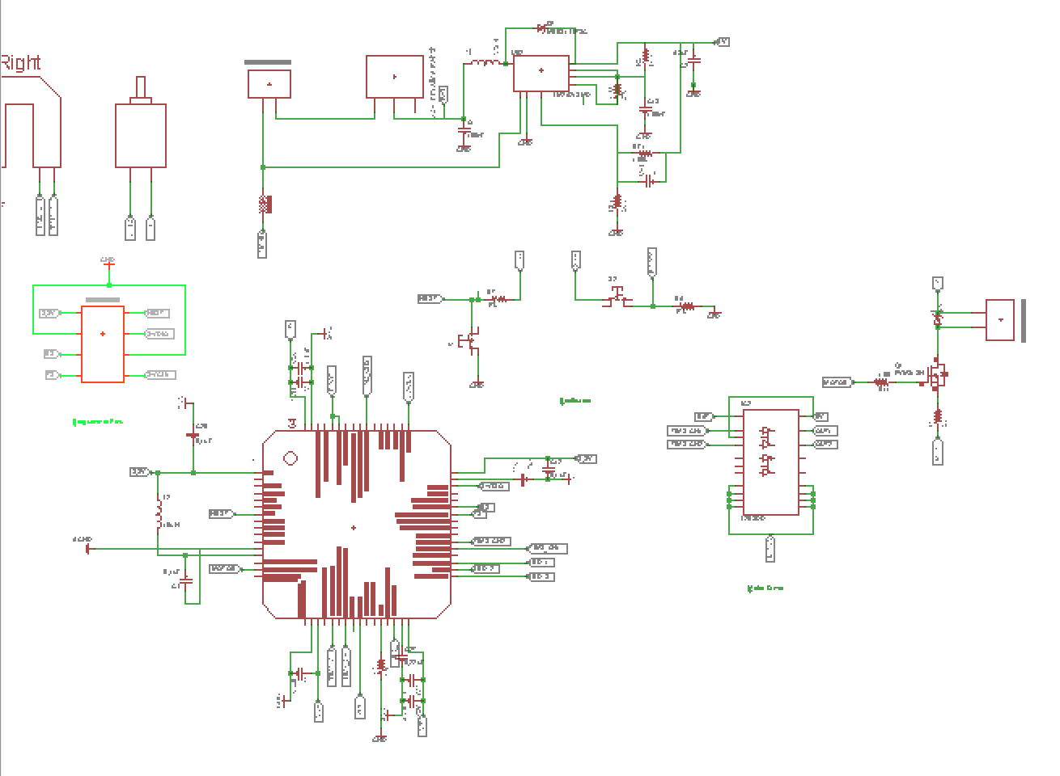
Off Center Spinning Mass PCB Design
Initially:
Design a separate PCB for our spinning mass controller:
Needed Components:
MCU
Motor Driver
Voltage Regulator
DC motor
Encoder
Programmer pins
RF/Bluetooth Module
Same MCU as CF
Chosen Motor driver would not work on our specific motor
Voltage regulator is not needed
RF/Bluetooth module+programming (through micro usb is provided)
More robust connection to user controller

Slide 15
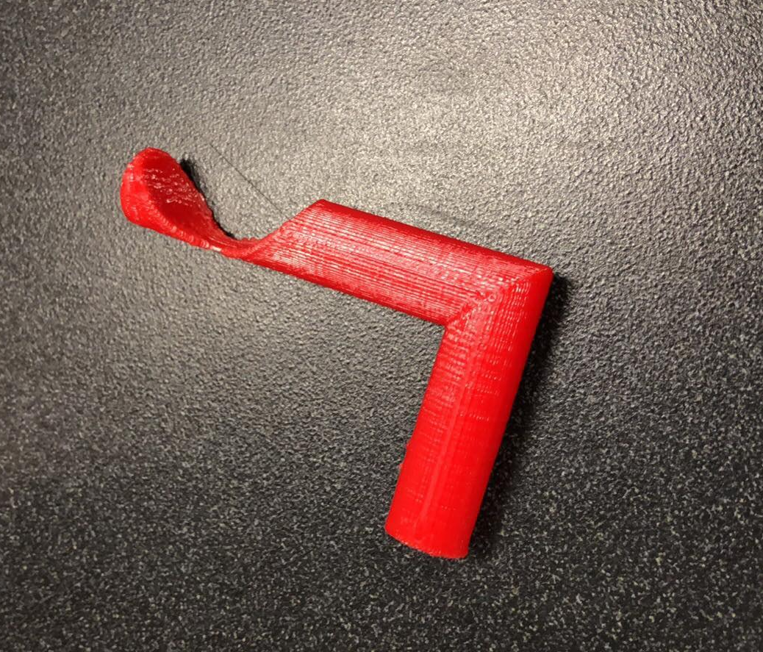
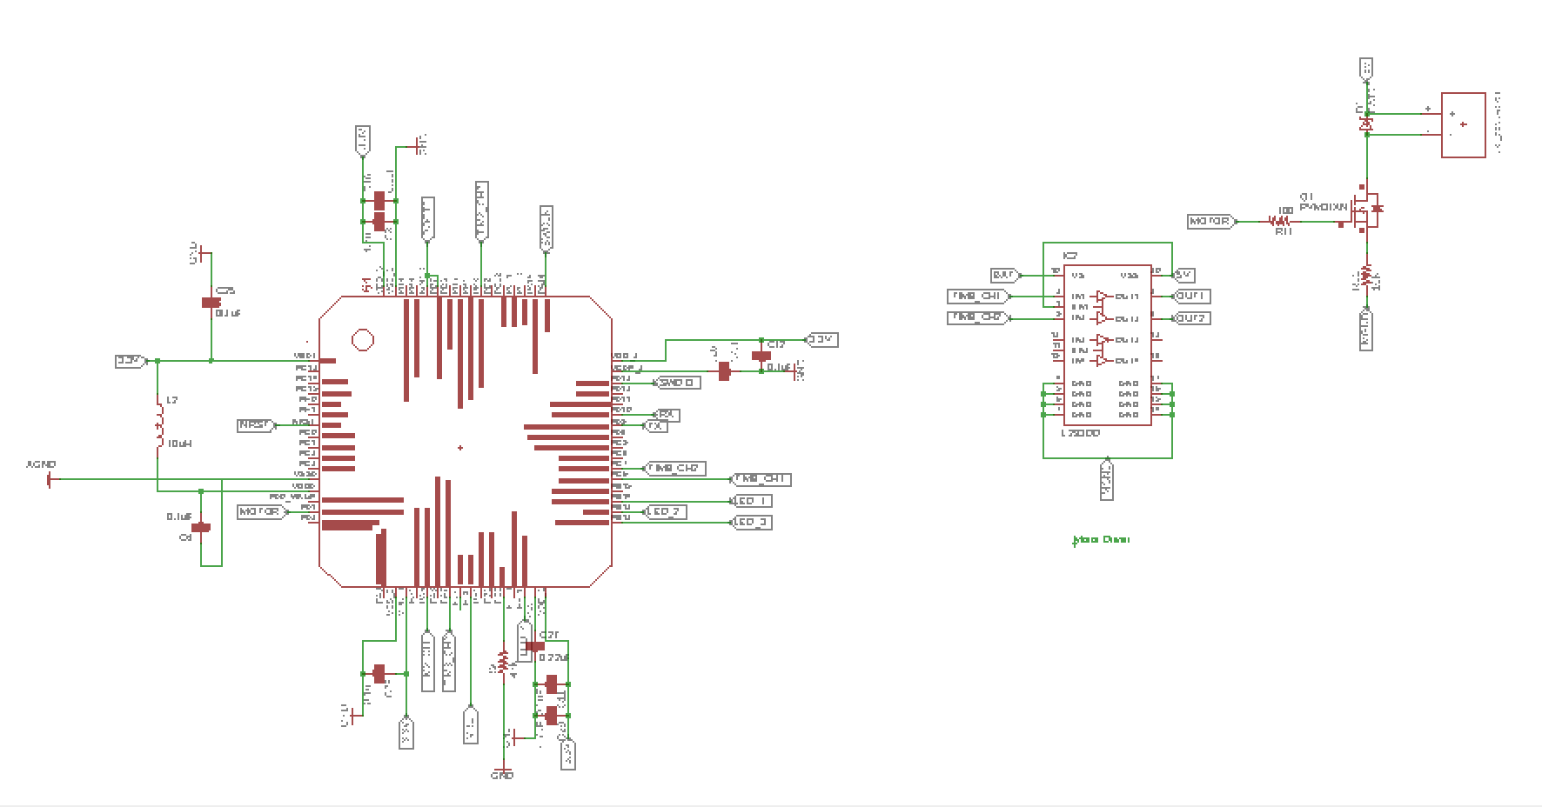
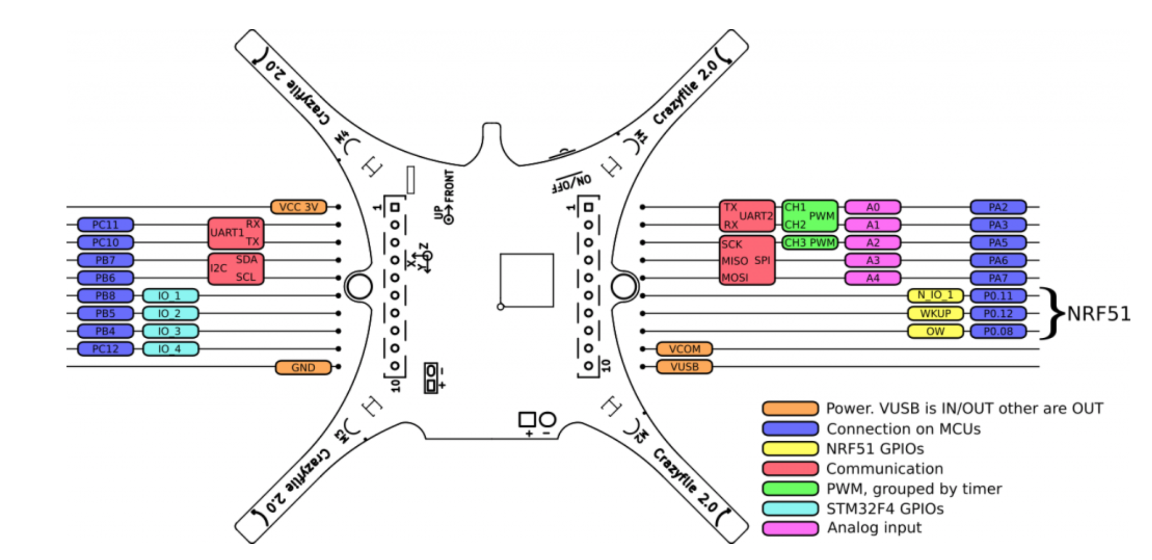
Off Center Spinning Mass Controller
Initial Prototype
Controller components
Crazyflie Component Placement
Encoder Motor

Slide 16
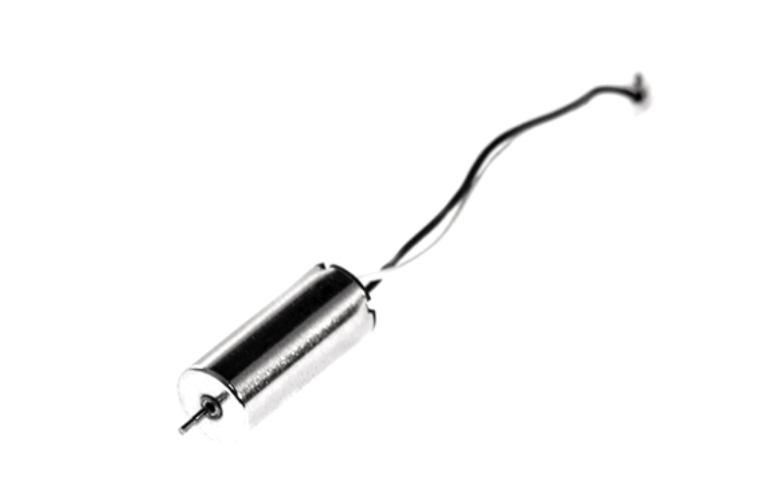
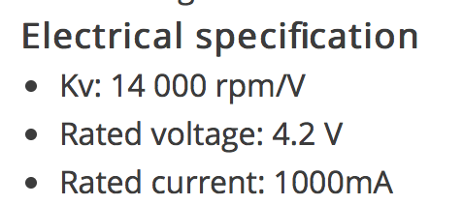
Off Center Spinning Mass DC Motor
Current and Power Calculation → Not following datasheet
No voltage regulator on CF schematics
Test results in lab :
We can run it at V=0.5v (with drawn current of 0.4)
Stall current ~ 3.5 A
Can rotate up to 40g mass
CF drone DC motor
From Simulation Data
Spinning mass < 6g

Slide 17
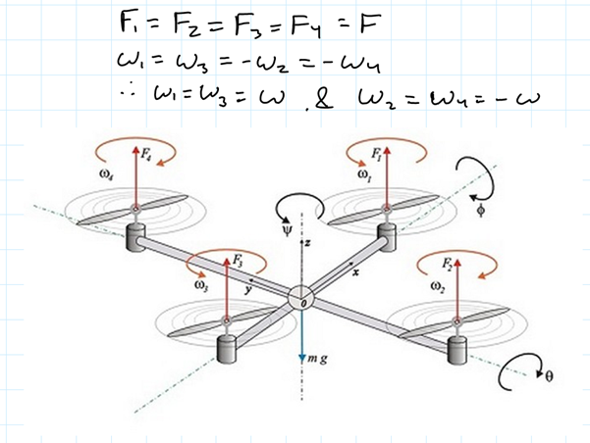
Differential Flatness & Drone Modeling
Mathematical Model
Differential Flatness
Including payload
Difficulties: math is hard & reworking our assumptions is time consuming
Design
Possible changes to better suit rocket model

Slide 18
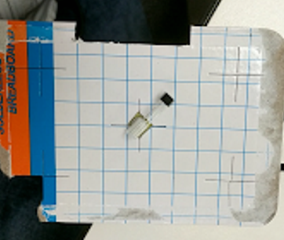
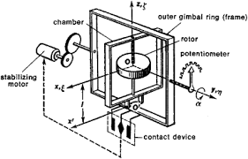
Analog control
Considered controlling the actuator & mass using a gyroscope with a potentiometer attached to it.

Slide 19
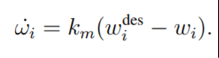
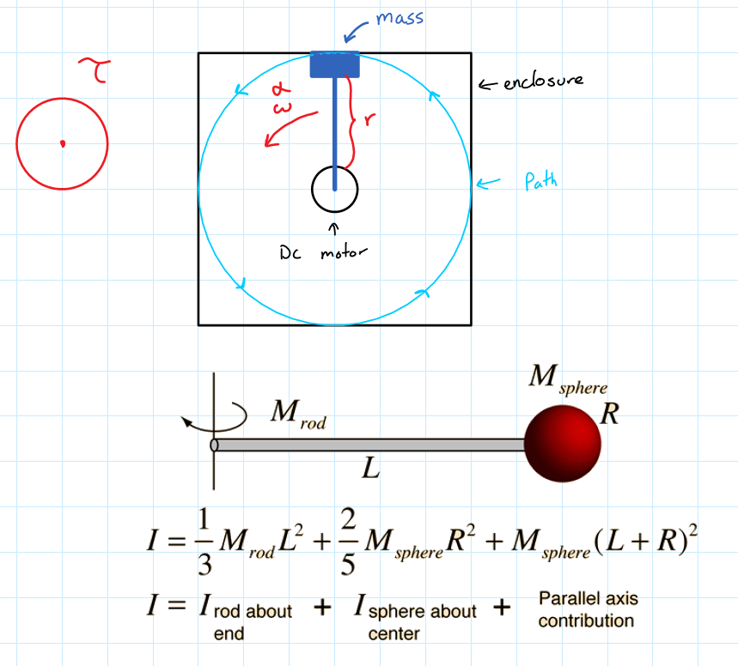
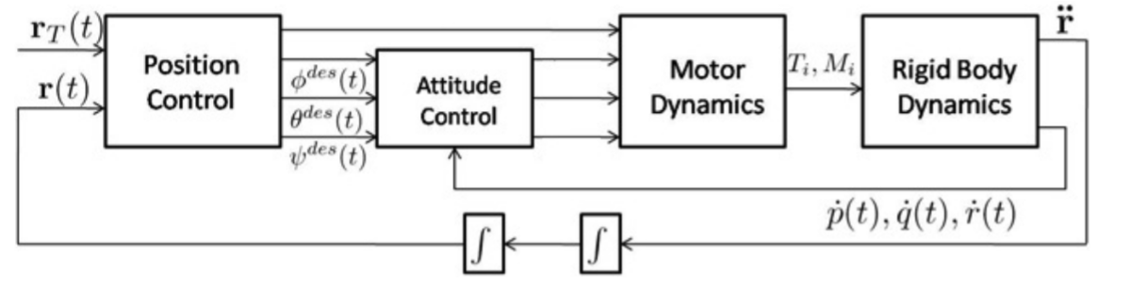
Motor Control
Rotor speed is approximately related speed by a first order D.E.
Generalized model for a motor
Motor control is no easy task either
Considers: Type of motor, drift, load, torque, RPM …
Motor models are are fairly well documented

Slide 20
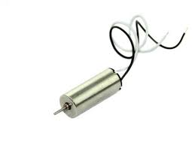
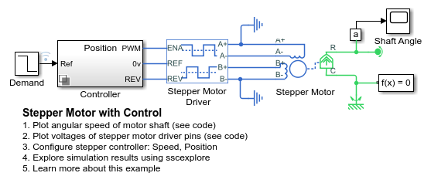
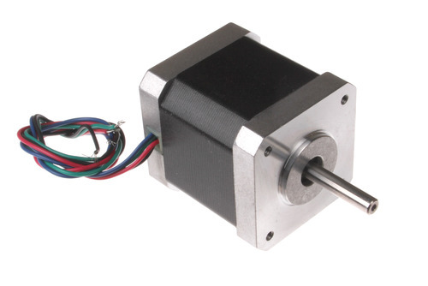
Motor Control
LabView vs SImulink
Stepper motor is likely best choice for proof of concept build
DC motor with encoder for the QuadCopter due to size/weight
*scaling not that off
https://www.mathworks.com/help/physmod/elec/examples/stepper-motor-with-control.html

Slide 21
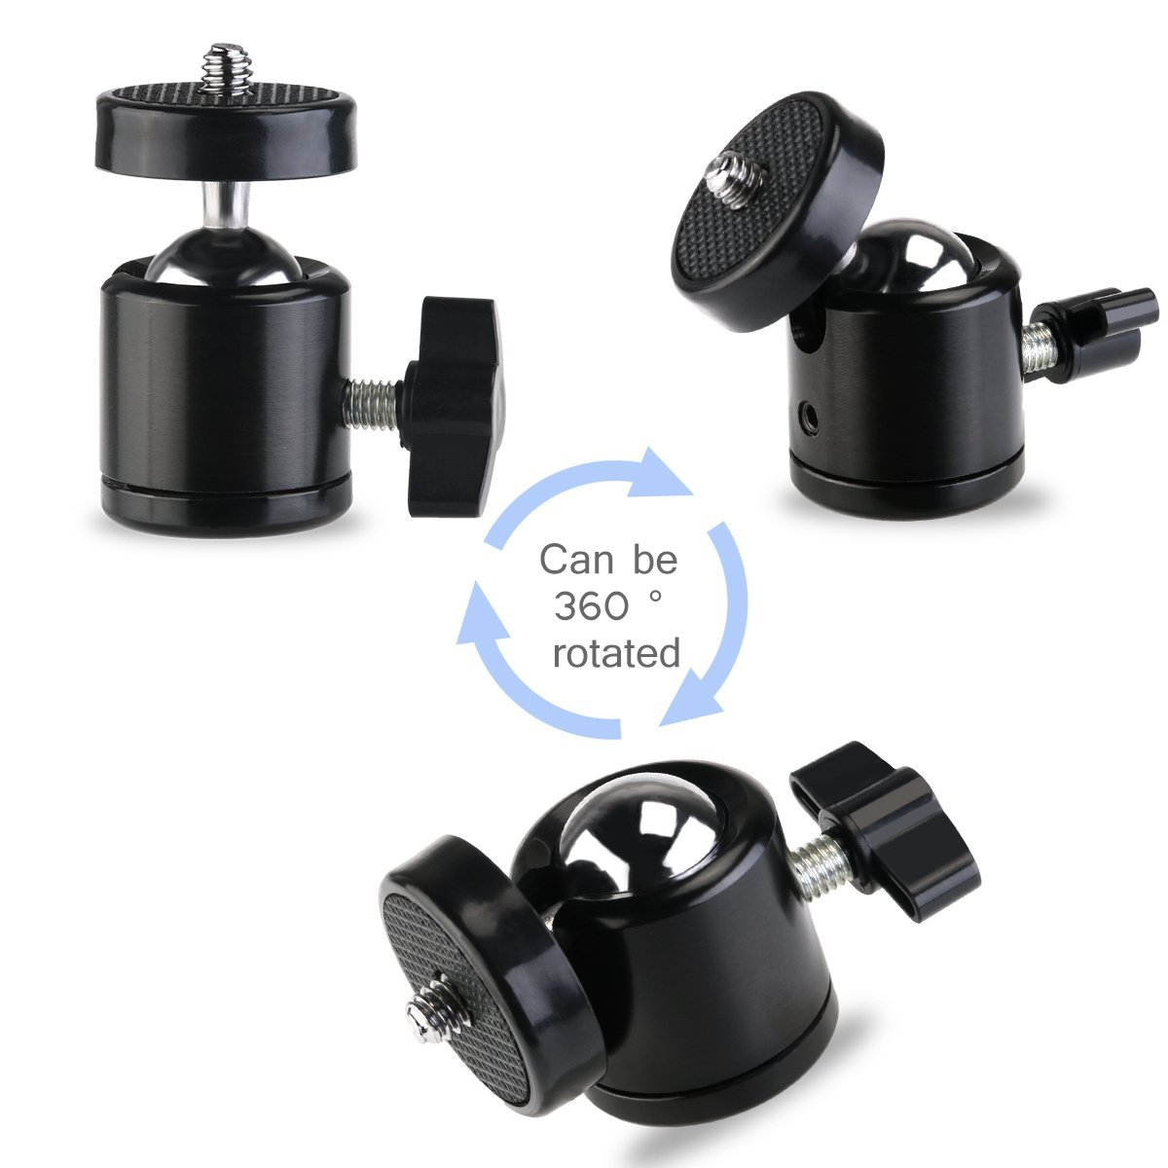
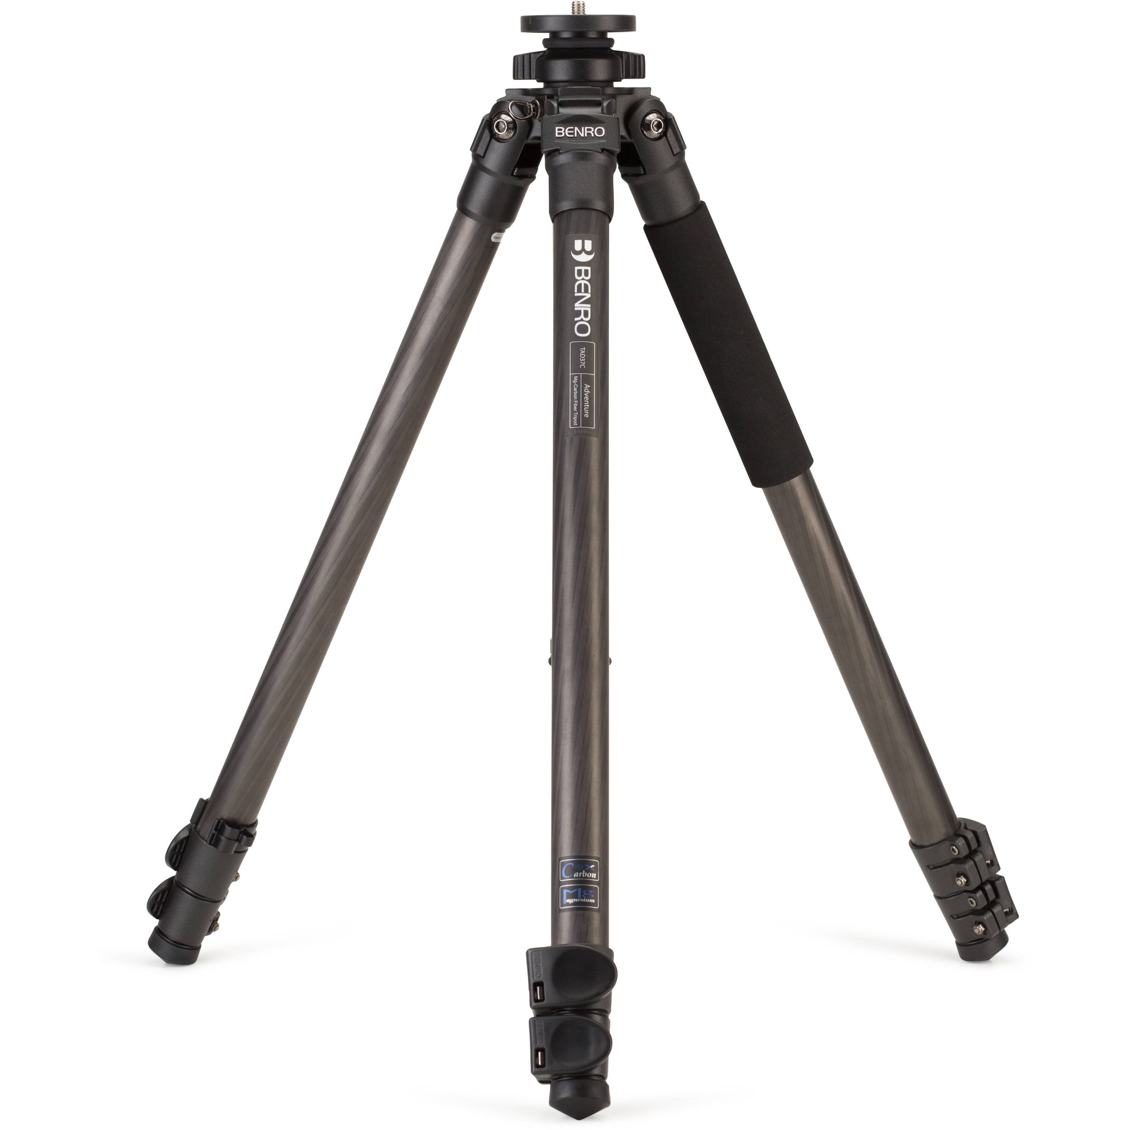
Proof of Concept Build
Using Fusion 360 to fabricate a mounting platform for the stepper motor and encoder that will be connected to a laptop running simulink to perform my tests.

Slide 22
Credits
https://www.seeedstudio.com/Crazyflie-2.0-Spare-7x16-mm-coreless-DC-motor-with-connector-p-2115.html
http://users.physics.harvard.edu/~morii/phys151/lectures/Lecture09.pdf
Headatchalkboard.png
https://www.mathworks.com/help/physmod/elec/examples/stepper-motor-with-control.html
https://store.bitcraze.io/products/6-mm-dc-motor
https://www.inventables.com/technologies/stepper-motor-nema-17
https://www.amazon.com/Pixnor-Tripod-Camera-Camcorder-Bracket/dp/B01EFI8LOO
https://www.bhphotovideo.com/c/product/1157871-REG/benro_tad37c_adventure_8x_carbon_fiber.html (a cheaper one)
https://encyclopedia2.thefreedictionary.com/Gyroscopic+Integrator
https://www.mathworks.com/help/physmod/elec/examples/stepper-motor-with-control.html
http://ctms.engin.umich.edu/CTMS/index.php?example=MotorPosition&section=SimulinkModeling
https://repository.upenn.edu/cgi/viewcontent.cgi?article=1705&context=edissertations

